Slide 1
Spearing and Netting 2021
Misi-zaaga’iganing

Slide 2
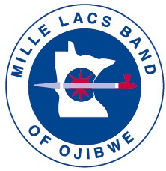
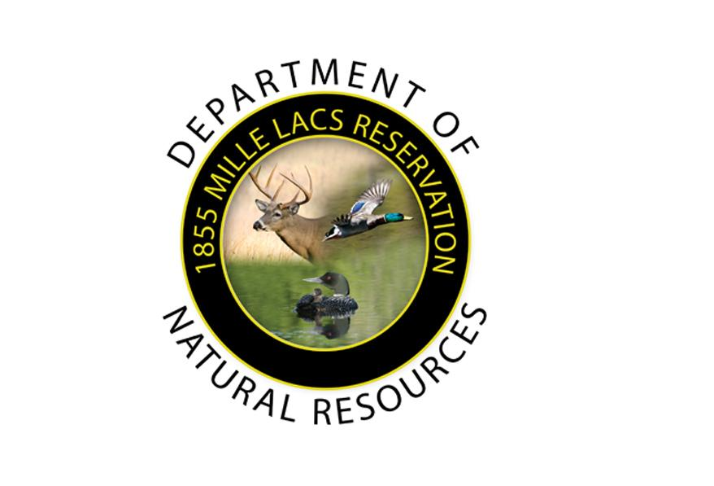
Boozhoo! Today’s Agenda
Welcome
1837 Conservation Code Basics
Harvesting Methods
Mille Lacs Harvester update from the 2020 season.
Brief FTC update – 2021
2021 Harvest Update – COVID restrictions will continue to be in place.
Let’s keep our harvesting traditions alive: Be a Mentor!
Q and A: Following the presentation, we will have time for questions.
Notes:
Welcome everyone. Miigwech for joining us today. I hope you find this meeting helpful and informative as we quickly approach this years Spring Harvest. My name is Katie Draper, and I serve the Band as the Commissioner of Natural Resources.
Before we begin today, I would like to take a moment of silence to remember our community members who have passed away this past year. Miigwech.
Here is an overview of what we will cover today. Some of this information was shared with community members who joined our zoom meetings during treaty rights week.

Slide 3
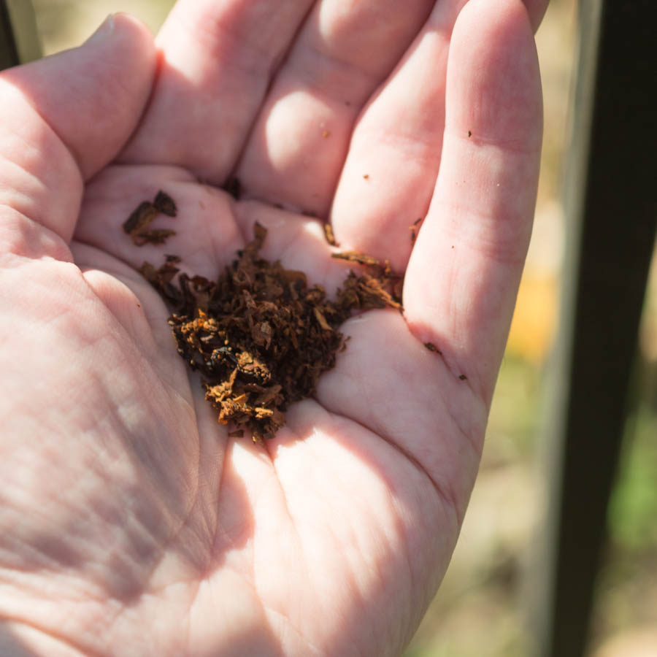
First things, first.
Zhakamodaw – If you have lost a loved one in the past year or it is your first time at spearing and/or netting, it is recommended that you are spoon fed prior to going out. If you need to be spoon fed, please contact our Cultural Resource team at 320-532-7439.
Biindaakoozh – make a tobacco offering.

Slide 4
1837 Conservation Code Basics
The 1837 Conservation Code requires Mille Lacs Band members to acquire Harvesting Permits from the Band’s Department of Natural Resources before they can hunt, fish and gather on Band and public lands within the 1837 ceded territory. In addition, it is required to have a form of ID on you while harvesting.
The 1837 Conservation Code can be found in Mille Lacs Band Statutes, Title 11, Chapter 5. As it relates specifically to Fish Harvesting Regulations, please refer to Subchapter 9 of the Conservation Code to find definitions, seasons, requirements, bag limits and regulations. Let’s take a quick moment and look at the Title 11.
I encourage harvesters to review the 1837 Conservation Code. There is a lot of additional information and opportunities available to us that we will not cover today due to time constraints.
All of the 1837 signatory Band’s follow the 1837 Conservation Code, and some, like us have additional laws they follow in regard to on-reservation harvesting. Over the years, this has caused confusion for some harvesters, and it is on my “to do list” to update the statutes to better align with the 1837 Conservation Code. Let’s take a light dive into harvesting method requirements.
Notes:
Light Dive = go to website and show people where to find the statutes and laws.

Slide 5
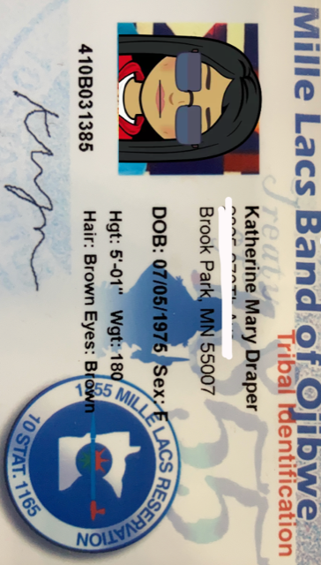
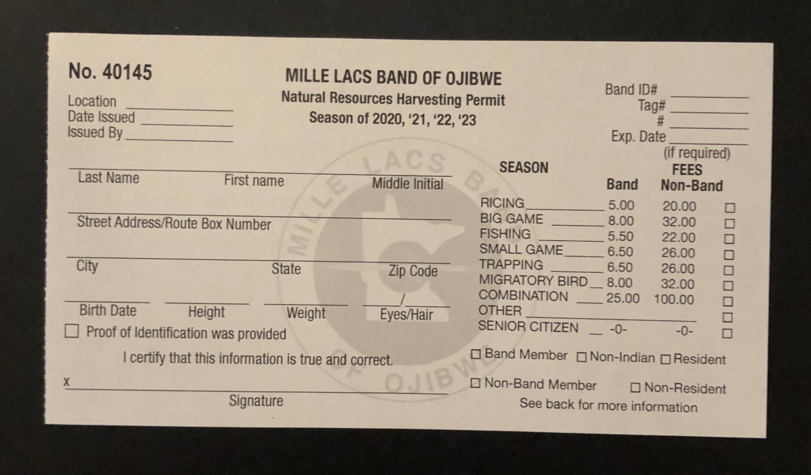
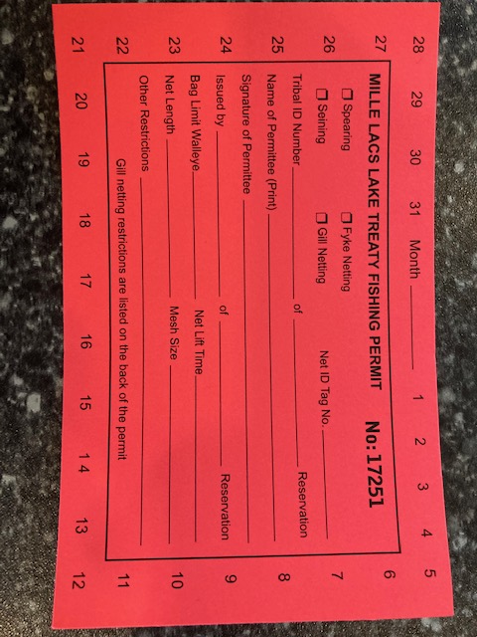
What do I need?

Slide 6
Harvest Methods - Gill Net
The Band’s DNR may issue gillnetting permits for: any lake in excess of 1,000 acres; Ogechie, Onamia or Shakopee Lakes; approximately five miles of the Rum River connecting these lakes: Grindstone, Eleven, Pine, Razor, South Stanchfield, Whitefish, and the 20 miles of the St. Croix downstream from the point where the river commences at the border between Minnesota and Wisconsin. There are provisions that can be found in the 1837 Conservation Code to further define. In general, during the spring GLIFWC meetings the Commissioner will declare all of the available lakes within the 1837 treaty area in Minnesota to allow harvesters the opportunity to harvest. Most often, those lakes do not attract harvesters from MLBO, but they are an option. If you have interest in harvesting from these lakes, please contact us at DNR.
Gill net size requirements are as follows:
  Must possess a netting permit.
  Length: 100ft
  Depth: 4ft
  Bar Size: 1.75in
  Shall be marked with two flags or floats, one at each end of the net. Flag (white, 10 inch square) must be two feet or more above the water.
  Net shall have an identification tag. Tags can be picked up at main DNR office. Phone number: 320-532-7439.

Slide 7
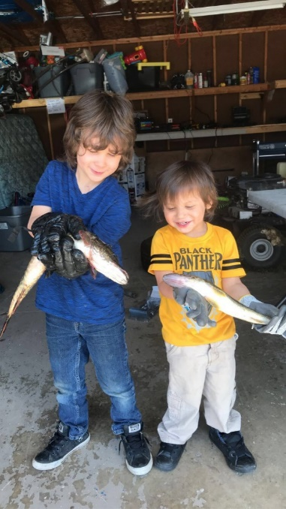
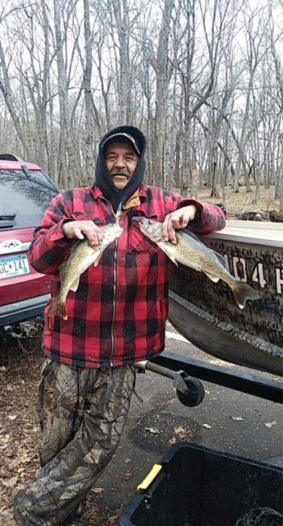
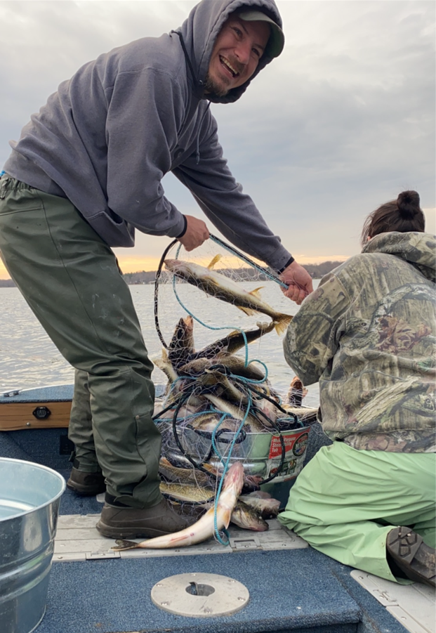
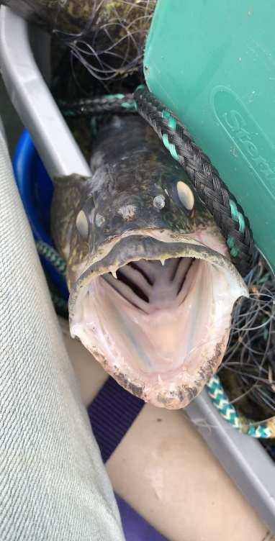
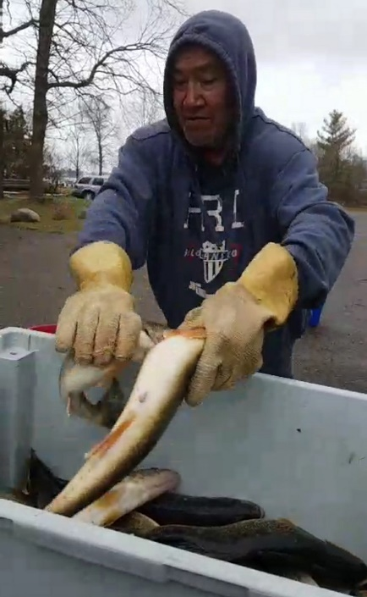
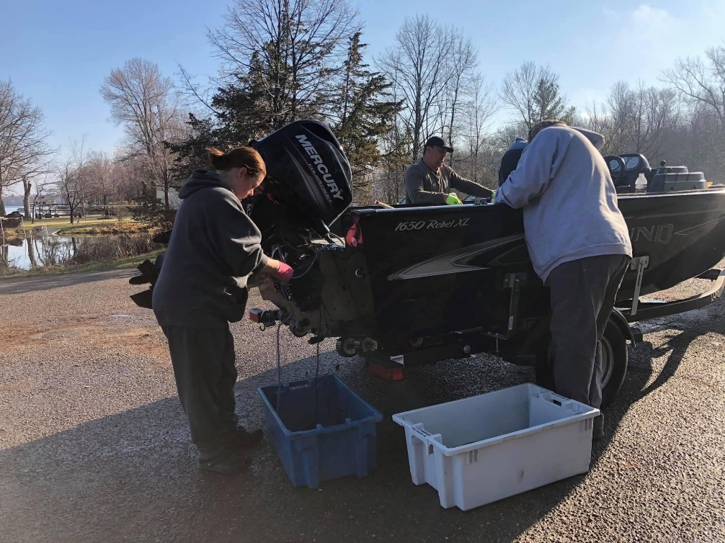
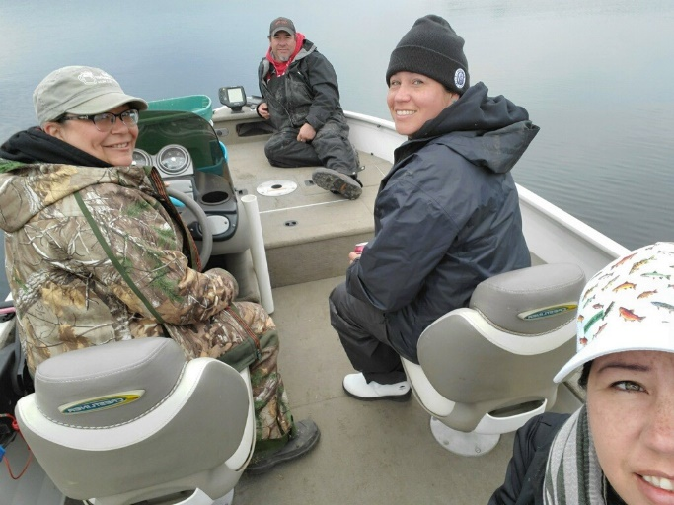
Gill Net Harvester Photos

Slide 8
Harvest Methods – Spearing
Spearing requirements:
  "Spear" means a pole tipped with a minimum of three barbed tines which are a minimum of 4-1/2" long and each tine having a barb extending perpendicular which is greater than 1/8 inch.
  Must possess a spearing permit.

Slide 9
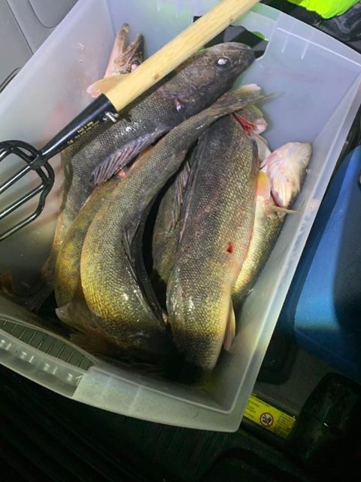
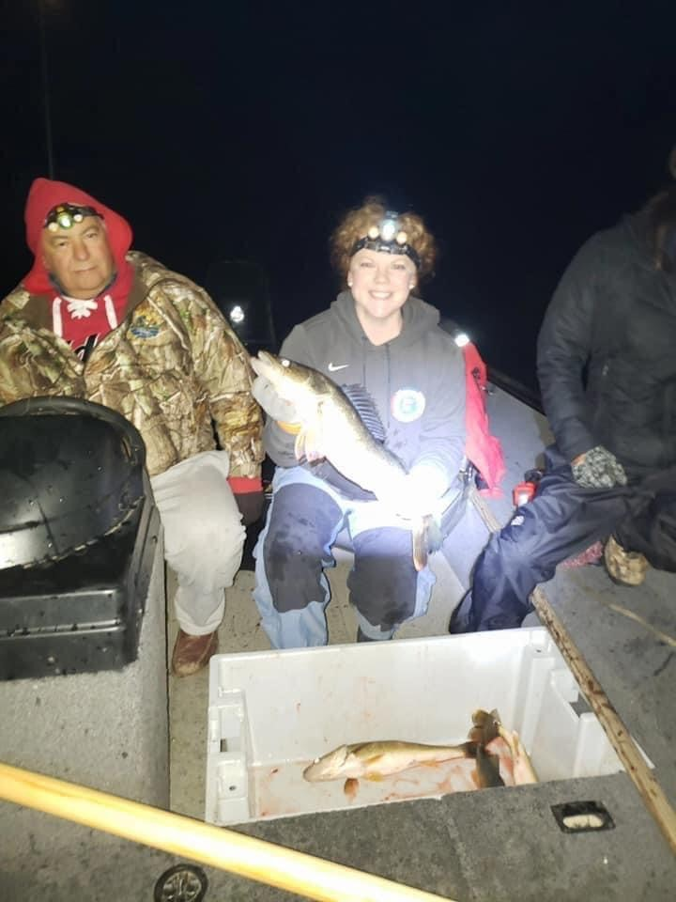
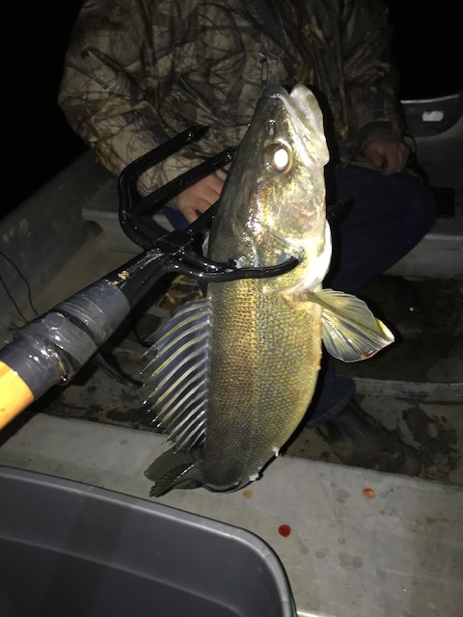
Spearing Harvester Photos

Slide 10
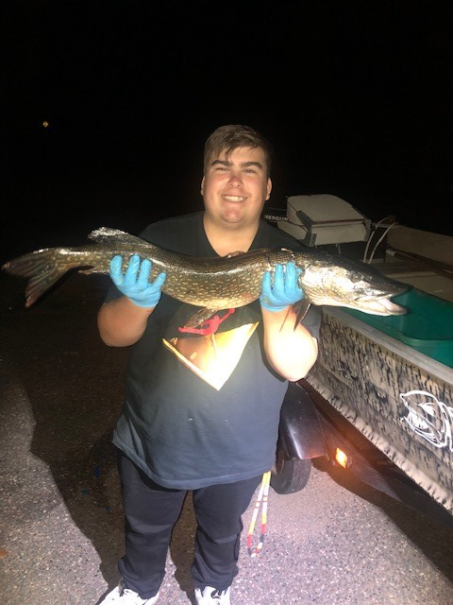
Northern are good too…
For years, approximately 50,000 pounds of northern pike are allocated to the Band’s.
In 2020, 866 pounds of northern pike were harvested by Mille Lacs Band members.
We encourage Tribal members to help recover the Mille Lacs walleye population by harvesting northern pike.
There are many ways to prepare northern pike such as: canning, pickling, baking, soup, fish cakes, chowder, etc.
If you are interested in learning how to clean or prepare northern pike, please give us a call: 320-532-7439.
Pike tend to congregate in shallow waters. If you need guidance on potential locations to set nets for pike, let us know.
There are fish consumption guidelines for pike available at the DNR office.

Slide 11
2020 Harvest Update Overview
MLBO harvested 15,836 of 17,779 original allocated pounds in 2020.
When compared to 2019 (same allocation), we had an increase of nearly 2,000 pounds of ogaa harvested in 2020. This includes spring and fall harvest combined.
The total number of MLBO harvesters that exercised their treaty rights in 2020 season was the highest it has been since 2013, with a total of 154 harvesters. 2012 (225 harvesters) had the overall highest on record and represents harvest before the quota was reduced significantly.
11,040 pounds of ogaa were taken by net and 4,336 pounds of ogaa were taken by spear for the spring season. The remaining 460 pounds were taken during the fall season by both net and spear.
Spearing harvest ran from April 5th to June 1st.
Netting season ran from April 25th to May 8th.
Initially spearing permits allowed 10 walleye per permit, but increased to 20 shortly into the season.

Slide 12
2020 Harvest Update Overview – cont.
At peak gill net harvest 63% of the total walleye harvest was taken between April 29-May 2 (see diagram below).
Ice out on Mille Lacs was April 26, 2020.
Figure - Ziigwan (spring 2020) ogaa harvest by date (x-axis). Lbs of ogaa are on the y axis. The Blue line is the total amount (lbs) of ogaa taken with both net and spear. The green line is the amount of ogaa taken by gill net.

Slide 13
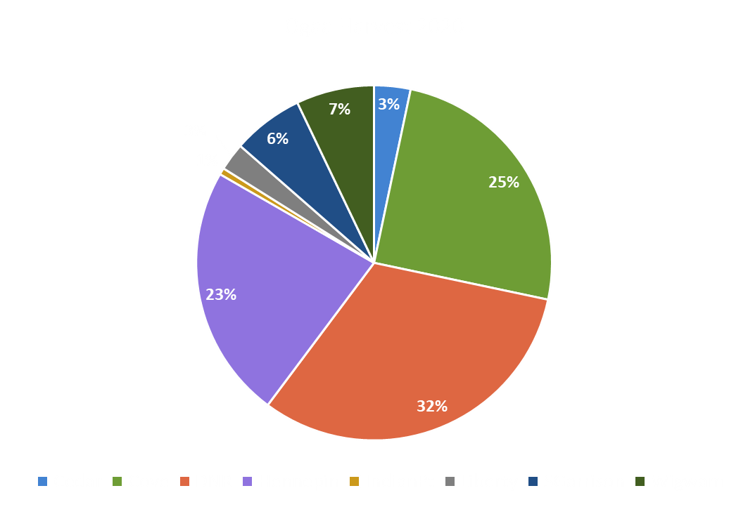
2020 Harvester Update Overview – cont.
In 2020, 80% of ogaa harvested came from three landings: DNR, Hennepin, and Cove. Wigwam was the 2nd most used (7%) and was followed by South Garrison (6%). This is similar to previous year landing usage data. North Garrison was reported unusable, so that landing was not utilized in 2020.
Landing | Ogaa lbs
Cedar | 523.6
Cove | 3962.1
DNR | 5048.4
Hennepin | 3661.5
Indian Point | 96.1
Liberty | 398.5
South Garrison | 1022.3
Wigwam | 1124.1
Cove
Hennepin
DNR (Pow Wow Grounds)

Slide 14
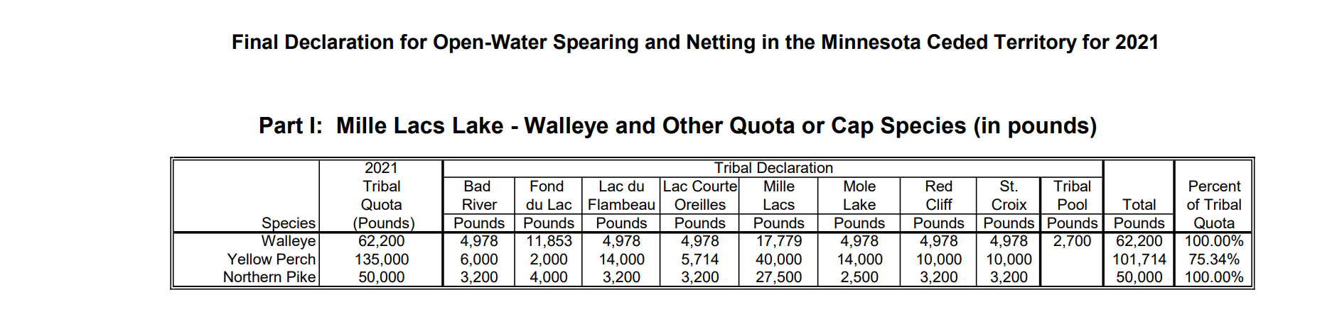
2021 FTC (Fisheries Technical Committee) Update
As required by the protocols established by the 1999 Supreme Court Case Victory, the 1837 Band’s, GLIFWC and the State of Minnesota work collaboratively to set safe allowable harvest levels for Mille Lacs Lake.
You may notice Fond Du Lac has a higher allocation than the other tribes. This is because they have demonstrated a greater need to feed their communities and they are a Minnesota Tribe.
After June 1st of every year, 50% of the remaining quota for all the Wisconsin Band’s will transfer to Mille Lacs. The other portion is retained by the other Band’s for a fall harvest.
Most often our perch harvest is very minimal. MLBO and the State DNR are assessing the actual population of the yellow perch in Mille Lacs Lake. More information to come on this in years to come.

Slide 15
2021 Harvest Update
Due to the COVID-19 pandemic, and in effort to keep our communities as safe as possible, we have updated the harvesting guidelines for this year’s spring harvest season. We humbly ask that all Mille Lacs Harvesters respect and comply with this plan.
After internal discussion, the decision was made to not ask the Wisconsin and Fond du Lac tribes to travel to Mille Lacs Lake this year. All eight of the 1837 signatory Band’s have expressed interest and intend to travel to Mille Lacs Lake for the spring harvest. With that being said, in order to minimize the spread/risk of COVID-19, we ask Mille Lacs tribal harvesters to only use the landings identified below. We realize that some MLBO harvesters enjoy harvesting at off reservation landings, but encourage harvesting at on reservation landings in effort to continue to slow the spread of the virus between communities. The intention is not to prevent or limit anyone from exercising their Treaty rights, but is to protect the health and safety of our communities. All of the Wisconsin Band’s, along with Fond Du Lac and Mille Lacs Band are working on creating processes to keep our communities at designated areas and to demonstrate social distancing at landings.
Open landings for a particular day will be determined by a committee consisting of DNR staff, tribal harvesters and Elders. Considerations for the open landing will include: weather, wind and ice. Please respect the decision of the committee as we want to ensure the safety of our communities. The committee will determine what landings are open by 9am, and will notify harvesters via text alert system.
Due to limited creel teams, staff numbers and safe distance practices, up to 4 landings will be declared per day. The landings we have identified to harvest from for this year: Wigwam, Indian Point, DNR (Pow Wow Grounds), Cove and Father Hennepin. Although we are going to do our best to harvest from these landings only, the committee may consider off reservation landings in the event of unforeseen weather events that affect access to the landings already identified. Again, we are attempting to reduce the spread of COVID-19 and appreciate your understanding in these challenging times. It is likely off reservation landings will be declared by Fond Du Lac or Wisconsin Band’s, and if MLBO harvesters choose to harvest at the same off reservation landings, please let MLBO DNR know so we can be sure to have a creel team available as we are doing the best we can to keep our communities safe.

Slide 16
2021 Harvest Update NEW!
EXCITING news to share:
First, beginning this year, harvesters can declare a landing 7 days a week(including Art Gahbow Day holiday). Harvesters must complete the Landing Declaration Form by 11:00am daily to allow DNR staff adequate time to notify GLIFWC/State. PLEASE be patient with us, as this is a new venture for the DNR team. How to declare:
Via Google Link (recommended method): Mille Lacs Band of Ojibwe Declaration Form
OR by phone: DNR Headquarters, D1: 320-532-7439
Steven Aubid, D2: 320-362-4123
Vanessa Gibbs, D3: 320-362-4647

Slide 17
2021 Harvest Update NEW cont.
Second, Harvesters do NOT need to physically come to the DNR Headquarters to pick up your permit as they will be issued at landings.
NETTING: During harvesting season there will be DNR staff member from 5:30-7:30pm to distribute permits at said landing. You must pick up your netting permit within that time.
SPEARING: During harvesting season spearing permits will be issued (same as previous years) at declared landings beginning at 8:00pm.
Make sure you have your tribal ID handy to expedite permit issuing.

Slide 18
2021 Harvest Update – Text Alert
Harvester DNR Text Alerts – We will communicate via our Text Alert system and share which landings are declared.
Once landings are declared, please let us know as soon as possible the method you intend to harvest at the open landings.
To be added to the text alert list please contact: Alyssa Welsh, 320-362-1514. Please be prepared to share your name, cell phone number and cell phone provider.
If you do not want to sign up for Harvester DNR Text Alert’s please notify your preferred contact information to allow proper notification.

Slide 19
What to expect at the landings
In effort to keep crowds down to a minimum, harvesters are asked to remain in their vehicle while waiting to launch their boats. Please make sure your boat is ready to launch for when it is your turn.
While waiting in line to creel fish, maintain social distancing guidelines by keeping 6 feet between you and other harvesters.
Harvesters will have the opportunity to creel their own fish along with a certified creel monitor if they wish to do so to minimize exposure to others. If there are only a few harvesters at a landing at one time, they may not be asked to assist with their creel.
Harvesters are asked to keep their time spent at the landing to a minimum. This will keep the flow of people coming and going.
Harvesters will be highly encouraged to wear a mask.

Slide 20
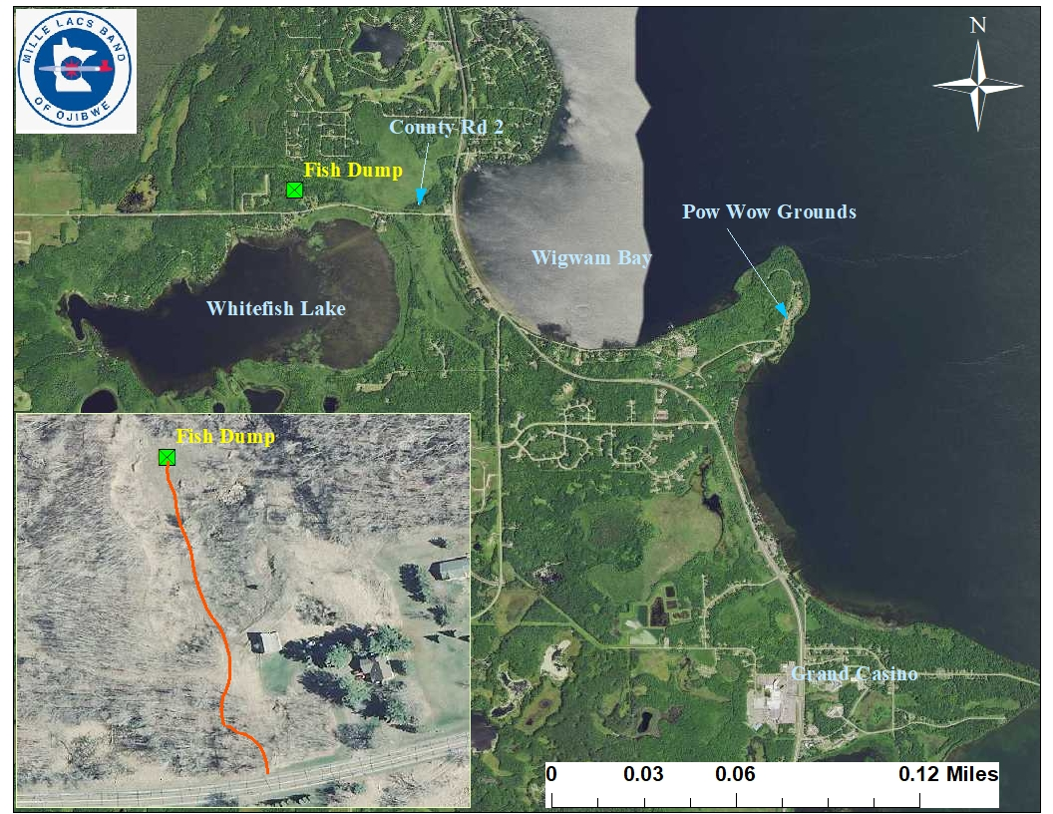
Fish Dump
Harvesters are asked to use the fish dump. If fish are left at locations other than the fish dump, it creates unpleasant work for others. The dump is off County Road 2 near Whitefish Lake. Side note: fish carcasses do make good garden fertilizer. Disclosure: You and your neighbors must be able to tolerate the stink, and attract hungry wildlife. Copies of the map to the dump will be provided at landings for those that need to verify the location. See map. Miigwech for your cooperation!

Slide 21
Conservation Officer Contacts
It is a crime to harass Tribal harvesters. Please contact MLBO Conservation Officer’s or Tribal PD for if you or someone you know is being harassed at landings.
  Special Voigt Task Force meeting update – Press Release.
  Practice 4 C’s:
    Create Distance
    Confirm your location
    Call CO or Tribal PD Dispatch
    Check in with MLBO DNR OR GLIFWC – All 8 Bands are working together to compile our data.
Note: IF you need to cancel your permit, it is your responsibility to contact any of the DNR Conservation Officers as soon as you are aware. Continued “no shows” to landings could hinder permits issued to you.
  Jason Rice: 320-630-2619
  Ashley Burton: 218-838-3379
  Jeffery Schafer: 320-630-2463
  Tribal Police Dispatch: 320-532-7490
Notes:
Harvester Harassment
Best Practices in the Event of Harassment
while Exercising Ojibwe Treaty Rights
Ojibwe tribal members have the right to exercise their inherent rights in a safe environment. If you are harassed while hunting, fishing, or gathering in the Ceded Territory, it is important to know how to take immediate action. Please follow the guidelines below to keep yourself safe and to properly document the occurrence. Following “The Four Cs” supports both short-term and long-term safety. Reporting harassment allows for enforcement intervention, which may reduce future incidents, creating a safer environment for all harvesters.
If you are harassed while exercising your treaty rights,
follow “The Four Cs”
Create Distance.
Staying safe should always be your #1 priority. If you are being physically harassed (rocks are being thrown, firecrackers set off, gunshots fired, etc.), immediately move to a location where you will be safe. The same is true if there is a verbal threat of physical harm (“I’m going to get my gun,” etc.). If you are being verbally harassed but there is no immediate threat of physical harm (you are yelled at to leave, called names, etc.), use your best judgment about continuing to harvest in that area. Never engage or provoke harassers.
Confirm your Location.
Documenting the location where harassment is taking place is important and helpful when contacting law enforcement and when filing a report. One of the easiest ways to confirm your location is to use a smartphone. Location mapping apps allow you to “Drop a Pin” to mark your exact location. Download the app to your phone prior to going out harvesting. Two of the most popular location mapping apps are Maps and Google Maps. The onX Hunt app is also frequently used for hunting. If you don’t have a smartphone, do your best to know and provide directions. Look for easily identifiable roads, landmarks, trees, docks, houses, house lights, etc.
Call 911.
In the event of physical harassment or a verbal threat of physical harm, CALL 911 IMMEDIATELY. Give them your name, location, phone number, situation, and any additional information the dispatcher may request. Provide your home phone number in addition to your cell phone in case you get disconnected, especially if you are harvesting in a remote area. You may be asked to stay on the line until officers arrive on scene to provide them with important updates. Once law enforcement arrives, they will address any active threat or emergency prior to taking a statement. Be prepared to spend some time at a safe location nearby so that you can provide the officer(s) with a detailed report.
Check in with GLIFWC.
If the harassment you are being subjected to does not warrant an emergency response, call GLIFWC Enforcement at 715-685-2113 to document the incident after you are done harvesting.

Slide 22
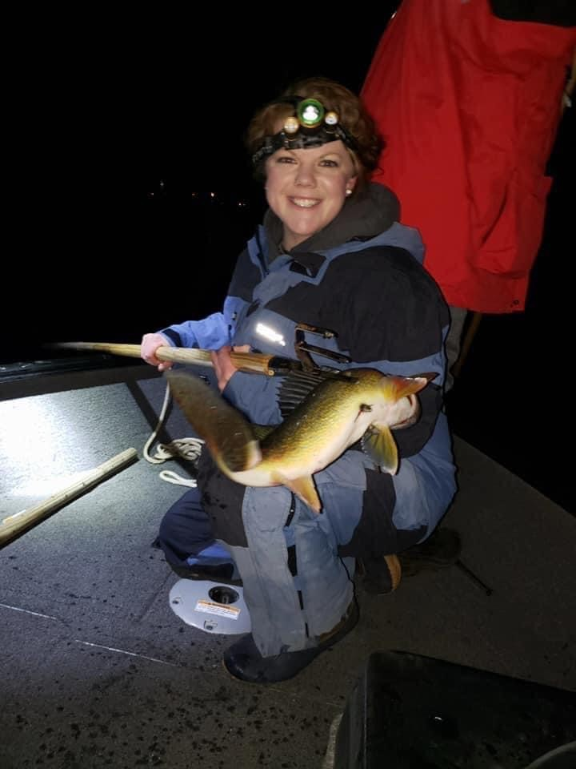
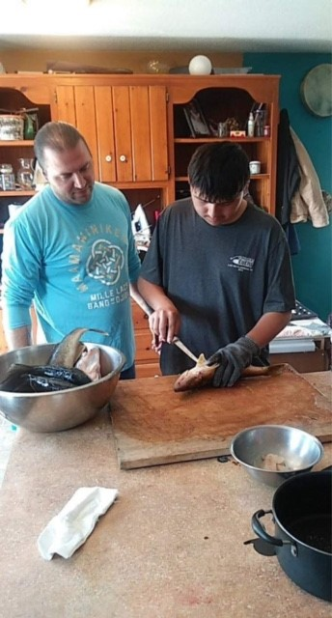
Let’s keep our harvesting traditions alive: We all learned how to exercise our treaty rights from someone, so let’s do our part and be a mentor to others.
Photo Submitted by Ashley Hanson.
“First walleye I had ever speared and my dad looked at me and said, “That feeling you have right now is the feeling of sovereignty.’”

Slide 23
Biindaakoozh
Don’t forget to put your asemaa down, treat your nets and fish as you would your most precious loved ones.
Your patience and understanding is appreciated. There is a lot to consider this harvesting season for all of our communities, and we at the DNR appreciate you working together to keep our communities as safe as possible.
Hopefully these safe harvesting practices will continue to aid in slowing the spread/risk of COVID-19 to our communities.
If you have additional questions or concerns, please contact Katie Draper, Commissioner of DNR at 320-515-0846. Miigwech.

Slide 24
Q and A
We covered a lot of material today as it relates to treaty harvesting, if you have additional questions we encourage you to give us a call at 320-532-7439.
Miigwech for your time today!

Slide 25
REMEMBER YOUR TRADITIONAL VALUES
Gwayakwaadiziwin (Honesty): To achieve honesty within yourself is to recognize who and what you are. Do this and you can be honest with all others.
Dabaadendiziwin (Humility): Humble yourself and recognize that no matter how much you think you know, you know very little.
Debwewiwin (Truth): To learn Truth, to live Truth, to walk Truth, and to speak Truth.
Nibwaakaawin (Wisdom): To have Wisdom is to know the difference between good and bad and to know the result of your actions.
Zaagi’idiwin (Love/Compassion): Unconditional love and compassion is to know that when people are weak, they need your love and compassion the most.
Manaadendamowin (Respect): Respect others, their beliefs. Respect yourself. When you practice respect, respect will be given back to you.
Aakode’ewin (Bravery/Courage): Have bravery and courage in doing things right even though it may hurt you physically and mentally.

